Slide 1
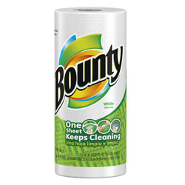
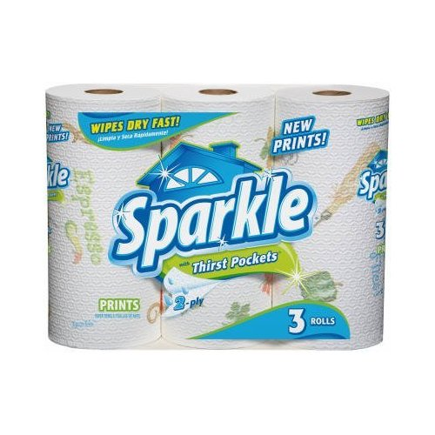
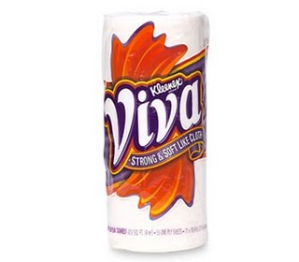
Paper Towel Lab
Which one is the best?

Slide 2
Problem
Today you work for the magazine “Consumer Reports” and your job is to rank the paper towels based on their absorbancy.
Bounty Commercial
Consider the science behind their claims:
Was there any data?
Do you believe them? Why should you?

Slide 3
Procedure
With your group, you need to develop a method for testing and ranking the 3 towels for the amount of water they absorb.

Slide 4
Procedure
Other things to consider when developing your procedure:
Do more than one trial
What will you measure?
How will you record your data (hint: data table)
What equipment will you need?

Slide 5
Procedure
When your group has written out your procedures, see Mr. Smith for approval. Every group member needs to have these copied down.

Slide 6
Data Collection
Today’s main rule:
DO NOT GET THE BALANCES WET.

Slide 7
Other helpful Data
Brand | Cost per Roll ($/roll) | Area of Towel (cm²/roll)
Sparkle (semi-generic) | 1.99 | 58,000 cm²
Viva | 2.99 | 39,000 cm²
Bounty | 2.69 | 51,500 cm²

Slide 8
Analysis & Conclusion to be turned in
Which paper towel tested picks up the most water for a given size sheet? (performance)
Which paper towel tested picks up the most water for your money? (value)
Are these answers different or the same? How could they be different?
What are some other things that could be tested? Give an example of a qualitative and quantitative characteristic.

